Slide 1
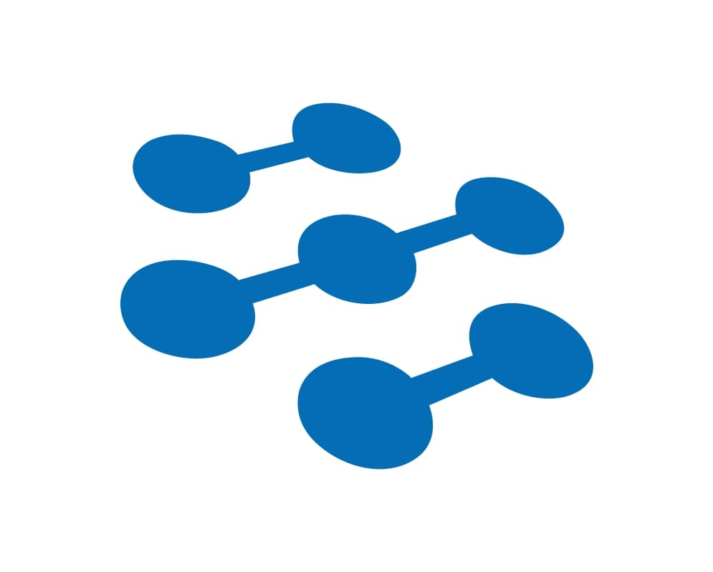



IEEE COINS 2023
Use It Or Lose It: An Economic VCG Auction Approach For NOMA Wireless Relay Networks
Yutong Song, Krishna Murthy Kattiyan Ramanoorthy, Wei Wang, Kazem Sohraby
San Diego State University
Utah Valley University

Slide 2
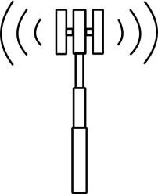



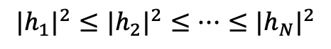
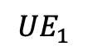
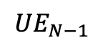
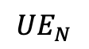
Part 1
Part 2
Part 3
Part 4
Part 5
Background
Non-Orthogonal Multiple Access (NOMA) wireless networks, the base station broadcasts the aggregated contents to all users via superposition coding, and users decode the broadcast contents via successive interference cancellation.
Users at shorter distances with stronger signals have already decoded the contents of those users at longer distances and with weaker signals.
$${{|h}_{1}|}^{2}≤{{|h}_{2}|}^{2}≤…≤{{|h}_{N}|}^{2}$$
……
$${UE}_{1}$$
Base Station
$${UE}_{N−1}$$
$${UE}_{N}$$

Slide 3

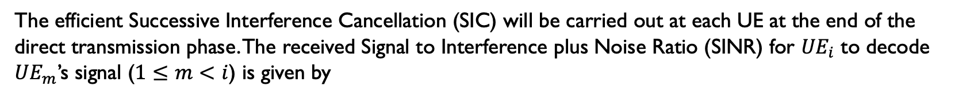

Part 1
Part 2
Part 3
Part 4
Part 5
NOMA Fundamentals in Wireless Transmission
Benefiting from the NOMA scheme, the BS serves $N$ UEs simultaneously through the downlink at the direct transmission phase.
Let ${|h_{i}|}^{2}$ denote the Rayleigh fading channel gain of ${UE}_{i}$. Without loss of generality, we assume that the UEs are ordered based on their channel gain:
$${|h_{1}|}^{2}≤{\left|h_{2}\right|}^{2}≤…≤{|h_{N}|}^{2}$$
The efficient Successive Interference Cancellation (SIC) will be carried out at each UE at the end of the direct transmission phase. The received Signal to Interference plus Noise Ratio (SINR) for ${UE}_{i}$ to decode ${UE}_{m}$’s signal ($1≤m<i$) is given by
$${SINR}_{i,m}= \frac{P_{m}{\left|h_{i}\right|}^{2}}{\sum_{k=m+1}^{N}{P_{k}{\left|h_{i}\right|}^{2}+σ^{2}}}$$
Where the $P_{m}$ is the allocated power of ${UE}_{m}$ from the BS, the $σ^{2}$ denotes the variance of the normalized AWGN.

Slide 4
Part 1
Part 2
Part 3
Part 4
Part 5
Motivation：Lose it or use it
Can we leverage these NOMA contents which are already decoded at these short-distance users, and give them incentives to relay to longer distance users?
If yes, what would be the appropriate incentive?
How to match the RN and UE to get maximum utility?
$${{|h}_{1}|}^{2}≤{{|h}_{2}|}^{2}≤…≤{{|h}_{N}|}^{2}$$
……
$${UE}_{1}$$
Base Station
$${UE}_{N−1}$$
$${UE}_{N}$$

Slide 5








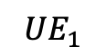
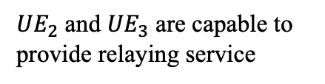
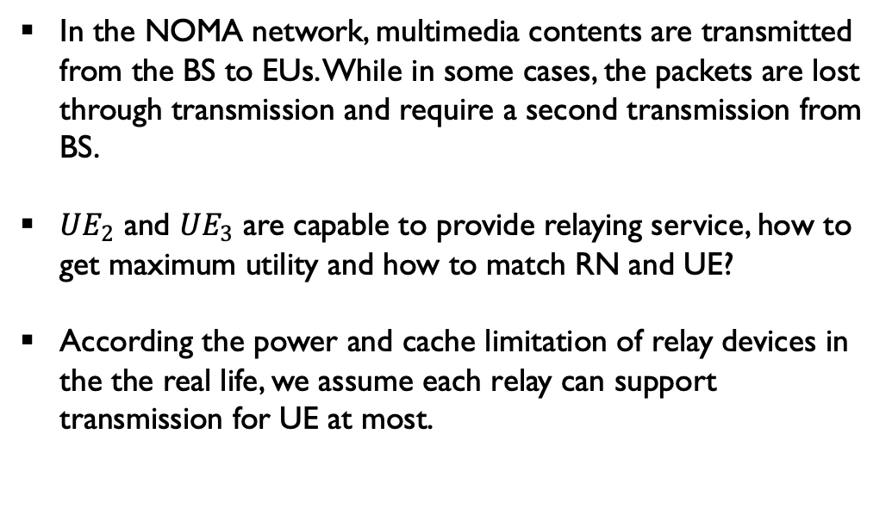
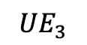
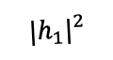
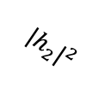
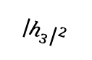
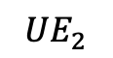

Part 1
Part 2
Part 3
Part 4
Part 5
Problem Statement and Assumptions
In the NOMA network, multimedia contents are transmitted from the BS to EUs. While in some cases, the packets are lost through transmission and require a second transmission from BS.
${UE}_{2}$ and ${UE}_{3}$ are capable to provide relaying service, how to get maximum utility and how to match RN and UE?
According the power and cache limitation of relay devices in the the real life, we assume each relay can support transmission for UE at most.
NOMA Downlink
D2D Relay Link
How to choose
$${{|h}_{1}|}^{2}$$
$${UE}_{1}$$
$${{|h}_{3}|}^{2}$$
$${UE}_{3}$$
$${{|h}_{2}|}^{2}$$
${UE}_{2}$ and ${UE}_{3}$ are capable to provide relaying service
$${UE}_{2}$$
Channel: ${{|h}_{3}|}^{2}>{{|h}_{2}|}^{2}>{{|h}_{1}|}^{2}$

Slide 6
Part 1
Part 2
Part 3
Part 4
Part 5
System model
In our work, RNs forward lost packages for UEs. And BS pays for RN’s service in the second transmission.
The incentive for RN directly comes from the payment of BS. Since the information is lost in the transmission from BS to UEs, in the second transmission UEs should be provided higher QoE.
BS will transmit signal to UEs with the same or higher lost if do not hire RNs to forward and thus RNs save the service and cost for BS.

Slide 7
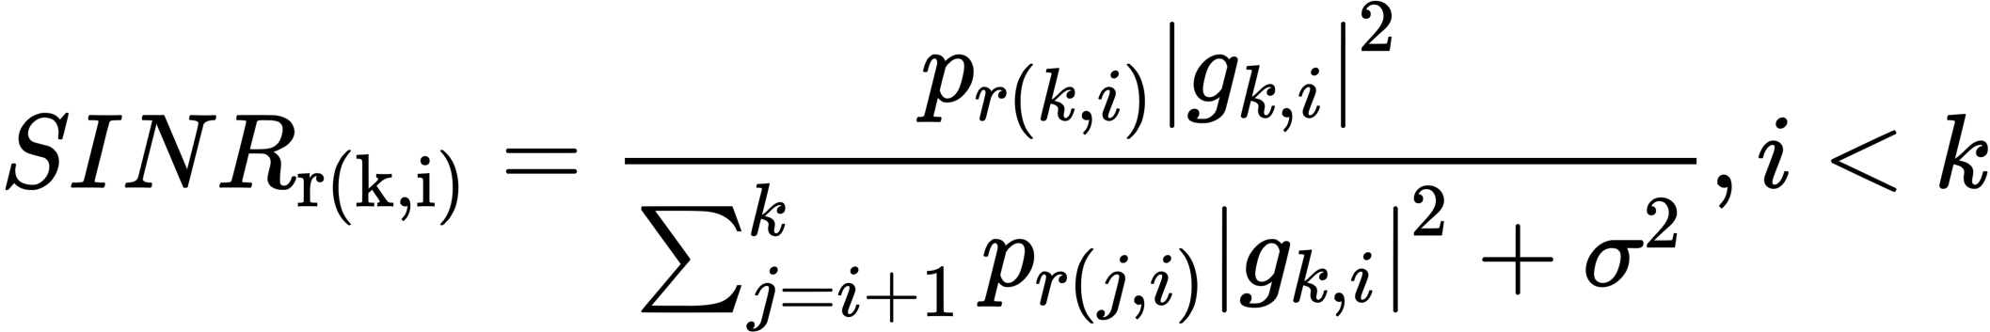
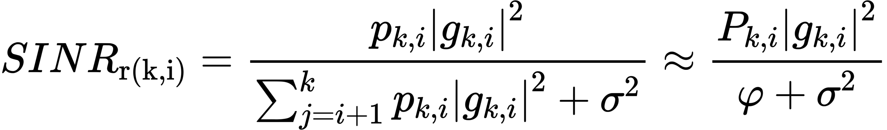
Part 1
Part 2
Part 3
Part 4
Part 5
System model
Each UE makes use of SIC technique to decode weaker UEs’ signals and subtract them to obtain its own signal, while weaker users treat stronger UEs’ signals as noise. In our model, the retransmission SINR from the kth RN to the ith UE can be represented as:
The retransmission SINR from the kth RN to the ith UE can be simplified as:
φ is a approximation value of Pk j=i+1 pk,i |gk,i| in the second transmission and pk,i is based on the channel gain between different UEs and RNs.

Slide 8


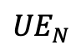
Part 1
Part 2
Part 3
Part 4
Part 5
System model: Base Station
The second transmission from BS
The second transmission from RNs
In the second transmission, the model of the QoE of i-th UE supported by k-th RN is:
$${UE}_{N}$$
$${RN}_{k}$$
$${UE}_{i}$$
.
.
.
We define the utility of BS as the QoE of UEs subtract the payment for RNs. Since BS will transmit signal to UEs with the same or higher lost if do not hire RNs to forward and thus RNs save the service and cost for BS:
$${UE}_{2}$$
Base Station
${RN}_{2}$
$${RN}_{1}$$
$${UE}_{1}$$

Slide 9
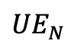
Part 1
Part 2
Part 3
Part 4
Part 5
System model: Relay Devices
The second transmission from BS
The second transmission from RNs
The utility of RN is defined as the incentive obtained from BS minus the forwarding cost.
The payment of weak UE is determined by its obtained utility from the relaying service.
The cost of RN is correlated with its energy consumption for the data relaying, proportional to the forwarding power Pr(k,i).
$${UE}_{N}$$
$${RN}_{k}$$
$${UE}_{i}$$
.
.
.
$${UE}_{2}$$
Base Station
${RN}_{2}$
$${RN}_{1}$$
$${UE}_{1}$$

Slide 10
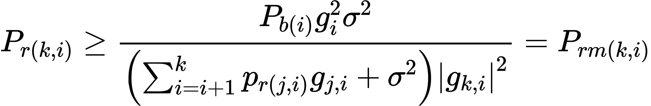
Part 1
Part 2
Part 3
Part 4
Part 5
System model: End Users
The second transmission from BS
The second transmission from RNs
The service from RN to U E in the second transmission should provide the same or better QoE compared with the signal from BS in the first transmission.
$${UE}_{N}$$
$${RN}_{k}$$
$${UE}_{i}$$
.
.
.
$${UE}_{2}$$
Base Station
${RN}_{2}$
Based on this Equation, we can get the power range for RNs in this model as [Prm(k,i), Pmin], in which Prm(k, i) is minimum relay power to support the relay service with better SINR.
$${RN}_{1}$$
$${UE}_{1}$$

Slide 11
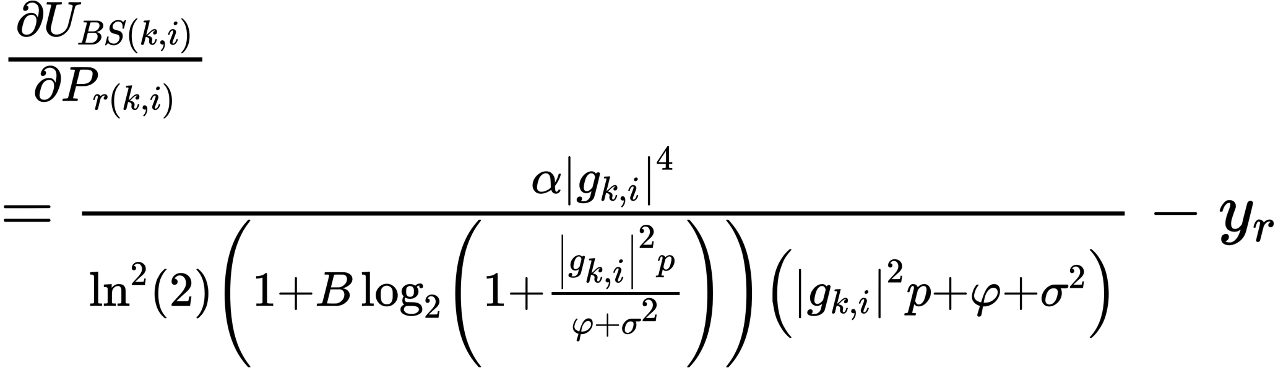
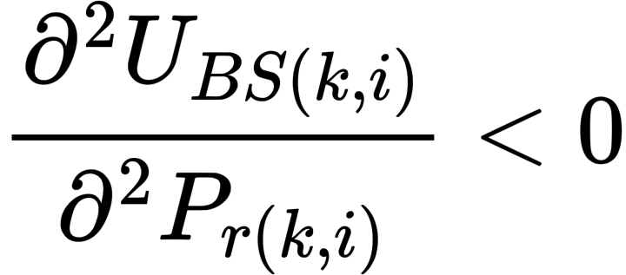
Part 1
Part 2
Part 3
Part 4
Part 5
Best Response of Base Station
We use a two-stage Stackelberg game to find the optimal power and price in each BS−RN−UE combination. We first find the best response of BS to get maximum utility.
The first order derivative of $U_{BS}$ (k,i) is :
The second order derivative of $U_{BS}$ (k,i) is:

Slide 12
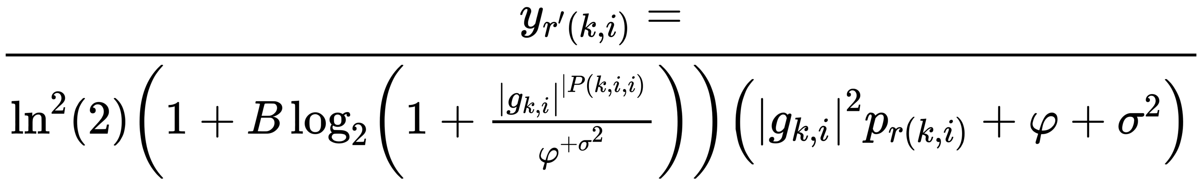
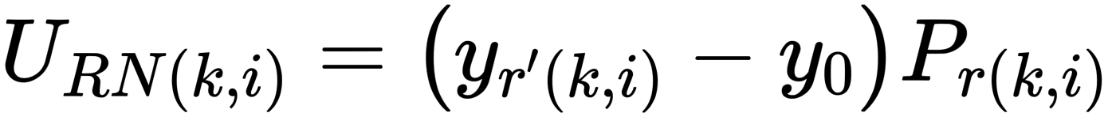
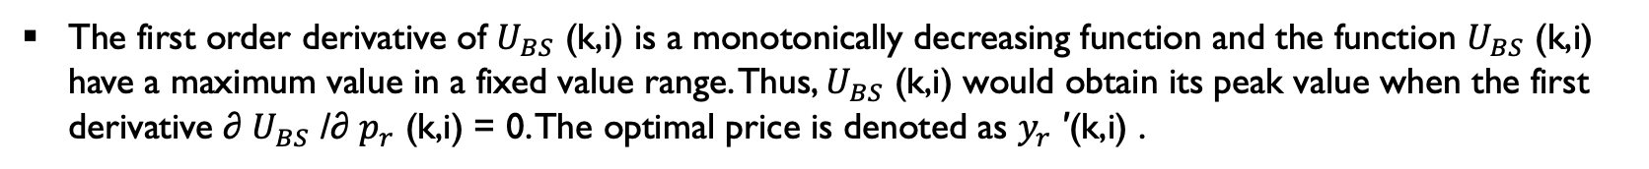
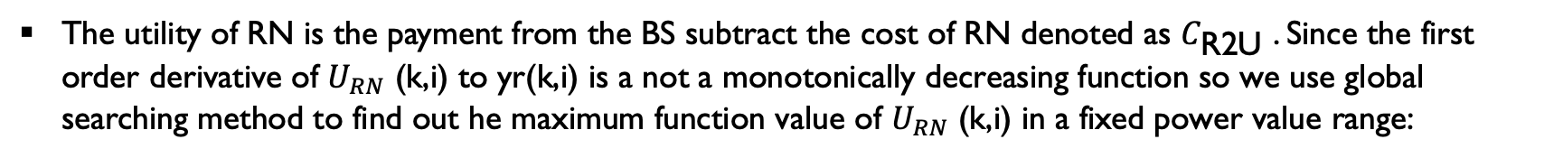
Part 1
Part 2
Part 3
Part 4
Part 5
Best Response of Relay Nodes
The first order derivative of $U_{BS}$ (k,i) is a monotonically decreasing function and the function $U_{BS}$ (k,i) have a maximum value in a fixed value range. Thus, $U_{BS}$ (k,i) would obtain its peak value when the first derivative ∂ $U_{BS}$ /∂ $p_{r}$ (k,i) = 0. The optimal price is denoted as $y_{r}$ ′(k,i) .
The utility of RN is the payment from the BS subtract the cost of RN denoted as $C_{\text{R}\text{2}\text{U}}$ . Since the first order derivative of $U_{RN}$ (k,i) to yr(k,i) is a not a monotonically decreasing function so we use global searching method to find out he maximum function value of $U_{RN}$ (k,i) in a fixed power value range:

Slide 13
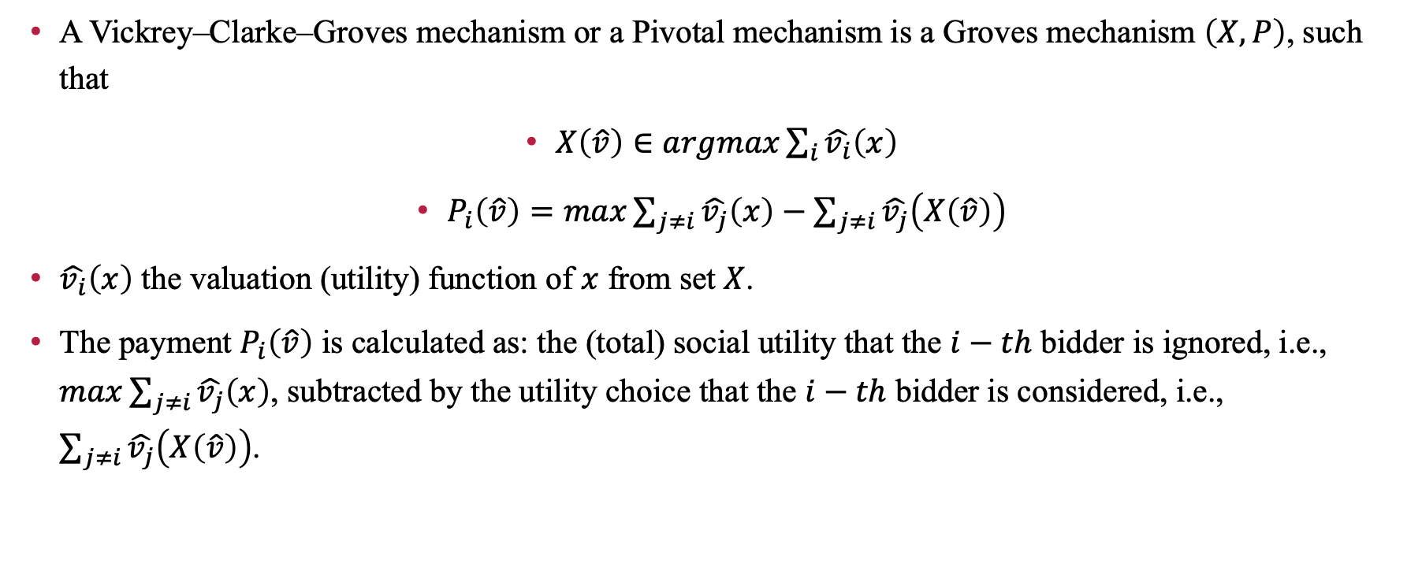
Part 1
Part 2
Part 3
Part 4
Part 5
Matching strategy: Vickrey–Clarke–Groves auction
A Vickrey–Clarke–Groves mechanism or a Pivotal mechanism is a Groves mechanism $\left(X,P\right)$, such that
$X\left(\hat{v}\right)∈argmax\sum_{i}{\hat{v_{i}}\left(x\right)}$
$P_{i}\left(\hat{v}\right)=max\sum_{j≠i}{\hat{v_{j}}\left(x\right)}−\sum_{j≠i}{\hat{v_{j}}\left(X\left(\hat{v}\right)\right)}$
$\hat{v_{i}}\left(x\right)$ the valuation (utility) function of $x$ from set $X$.
The payment $P_{i}\left(\hat{v}\right)$ is calculated as: the (total) social utility that the $i−th$ bidder is ignored, i.e., $max\sum_{j≠i}{\hat{v_{j}}\left(x\right)}$, subtracted by the utility choice that the $i−th$ bidder is considered, i.e., $\sum_{j≠i}{\hat{v_{j}}\left(X\left(\hat{v}\right)\right)}$.
A type of sealed-bid auction.
Bidders submit bids that report their valuations for the item(s), without knowing the bids of other bidders.

Slide 14
Part 1
Part 2
Part 3
Part 4
Part 5
Matching strategy: Vickrey–Clarke–Groves auction
In each BS−RN−UE combination, the utility optimization problem can be translated into a two-stage Stackelberg game. Both BS and RNs obtain their maximum utility when the game get Nash Equilibrium. (have done)
We are going to select the optimal RN for UE. As a typical sealed-bid auction, the NOMA relay nodes submit their bids that report their service valuation they can reach in the relay forwarding, without knowing the bids of others.
Tutility function of relay is considered as the service valuation and thus the maximum utility value from the first step is used for bidding in the game. Then, the base station serving as the broker will assign the relay service in a socially optimal manner. In this step, the utility function of relay is considered as the valuation and thus the maximum utility value from the first step is used for bidding in the game. Winners of the game are the optimal relays for U Es.

Slide 15
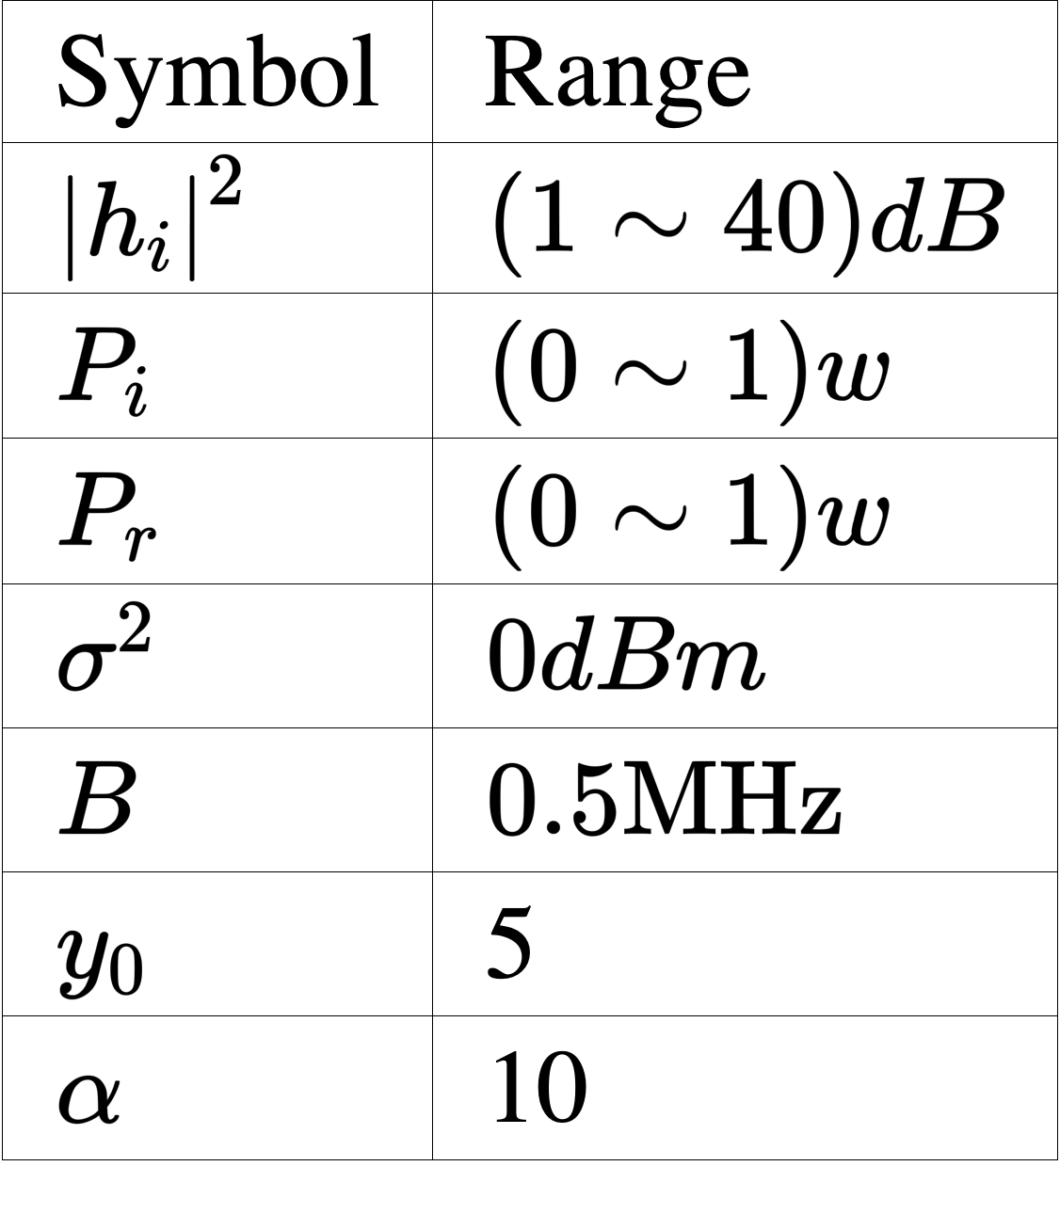
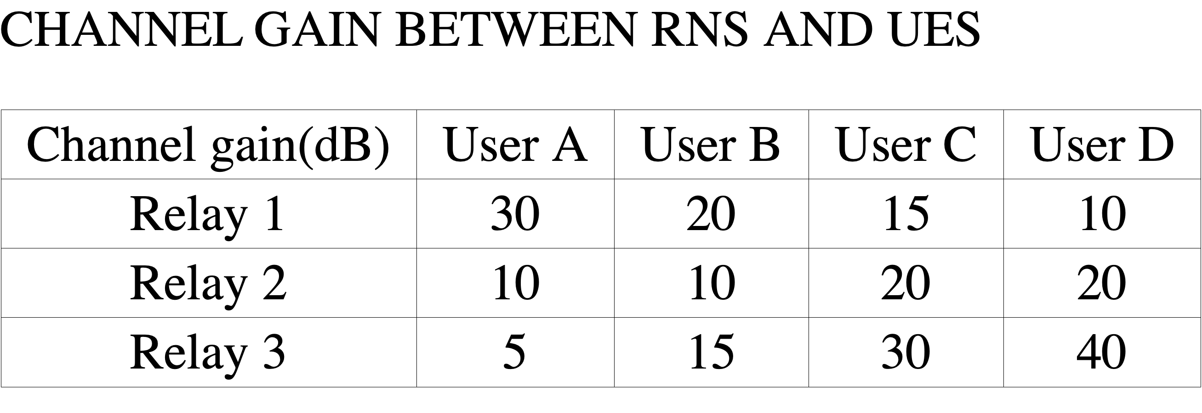
Part 1
Part 2
Part 3
Part 4
Part 5
Numerical Simulation Results
Simulations are taken with the BS power budget in a range from 0 to 1 watt. The maximum power that RN can support for EN s is the same as BS power budget.
We have power ratio PBS(A) : PBS(B) = PBS(B) : PBS(C) = PBS(C) : PBS(D) = 0.2. In the first transmission from BS to U Es, sum of power of U Es is the power budget.

Slide 16
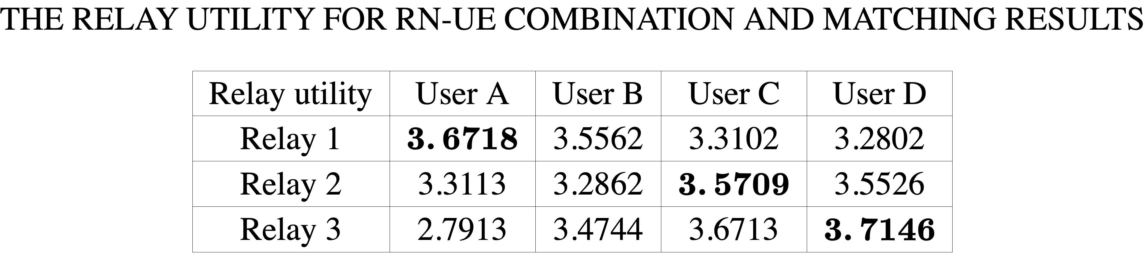
Part 1
Part 2
Part 3
Part 4
Part 5
Numerical Simulation
Using VCG auction relay matching algorithm with the power budget of 0.2W , the maximum and optimal utility for three RNs and four UEs are shown in Table below:
Based on our proposed pricing strategy, we choose the best RN for users using VCG auction and the results are highlighted in the Table. The best strategy is three combinations: Relay 1 - User A, Relay 2 - User C, Relay 3 - User D and the last User B should be serviced by BS directly.

Slide 17
Part 1
Part 2
Part 3
Part 4
Part 5
Result Analysis: Base Station
BS utility without RN to forward is shown in (a) and three situations the help of different relays are respectively shown in (b), (c) and (d).
We can find out When the power is very low under 0.1, it is more efficient to transmit directly by BS while the BS mostly earns more utility especially when the transmission power is high.
Therefore, BS saves power and resource in the second transmission to four users with RN.

Slide 18
Part 1
Part 2
Part 3
Part 4
Part 5
Result Analysis: Relay
The utility of RN with different channel gain to support UserB with 0.2w power budget is illustrated:
We can find out that as the channel gain increases and channel quality gets better, the optimal power for RN decreases because RNs can lower power can support the same service as BS for UEs.
In the Fig. (b), the maximum utility of different RNs with 0.2w budget supporting UserA, UserB, UserC and UserD are shown. We can see as the RN channel gain increases, the maximum of RN to support users increases. Due to interference estimated by the initiate power allocation, supporting UserA can gain more utility than other UEs for RNs with the same channel gain.

Slide 19
Part 1
Part 2
Part 3
Part 4
Part 5
Result Analysis: End Users and Network efficiency
Compare QoE of the four users if they are supported by different RNs and BS:
we can find out that users can obtain better service with relay than BS directly.
In the four sub-figures, QoE of UEs are respectively compared in four situations: with the help of relay 1, 2, 3 and without relay. Although different relays shows different performance for the network, QoE of all users significantly with relay forwarding. Therefore, UE receive more power and resource in the second transmission from RN rather than BS.
Compare the utility of relay in the optimal BS − UE combination and the utility of relay in a random combination:
The power budget is 1w and transmission power increases from 0.2w to 1w, we can see that VCG auction relay strategy shows better performance than non-auction theory from the perspective of relay and thus better allocated power and matching.

Slide 20
Part 1
Part 2
Part 3
Part 4
Part 5
Conclusion and Discussion
Inspired by use it or lose it concept, an economic VCG auction approach is proposed for downlink NOMA relay wireless networks in this paper.
Firstly, a two-step Stackelberg game is applied on the utility models for BS and RN to find the maximum network utility. Then VCG auction is adopted to let BS make the optimal RN−UE matching strategy.
Through VCG auction, BS and RN obtain their maximum utilities and U Es get good service directly from the relay rather than the BS.
Finally, simulation demonstrates the potentials of utility improvement of NOMA relaying service with VCG auction mechanism.

Slide 21
Part 1
Part 2
Part 3
Part 4
Part 5
THANK YOU !

